Slide 1
AI/ML Basics

Slide 2
What is Machine Learning ?
Machine learning is the art of study of algorithms that learn from examples and experiences.
Machine learning is based on the idea that there exist some patterns in the data that were identified and used for future predictions.
A computer program is said to learn from experience E with respect to some task T and some performance measure P, if its performance on T, as measured by P, improves with experience E.
Tom Mitchell, 1997

Slide 3
Why Machine Learning ?
Develop systems that can automatically adapt and customize themselves to individual users. — personalized news or mail filters.
Discover new knowledge from large databases (data mining). — Market basket analysis (e.g. beers

Slide 4
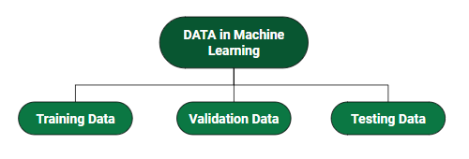
Data is Important
DATA: It can be any unprocessed fact, value, text, sound, or picture that is not being interpreted and analyzed. Data is the most important part of all Data Analytics, Machine Learning, Artificial Intelligence. Without data, we can’t train any model and all modern research and automation will go in vain. Big Enterprises are spending lots of money just to gather as much certain data as possible.

Slide 5
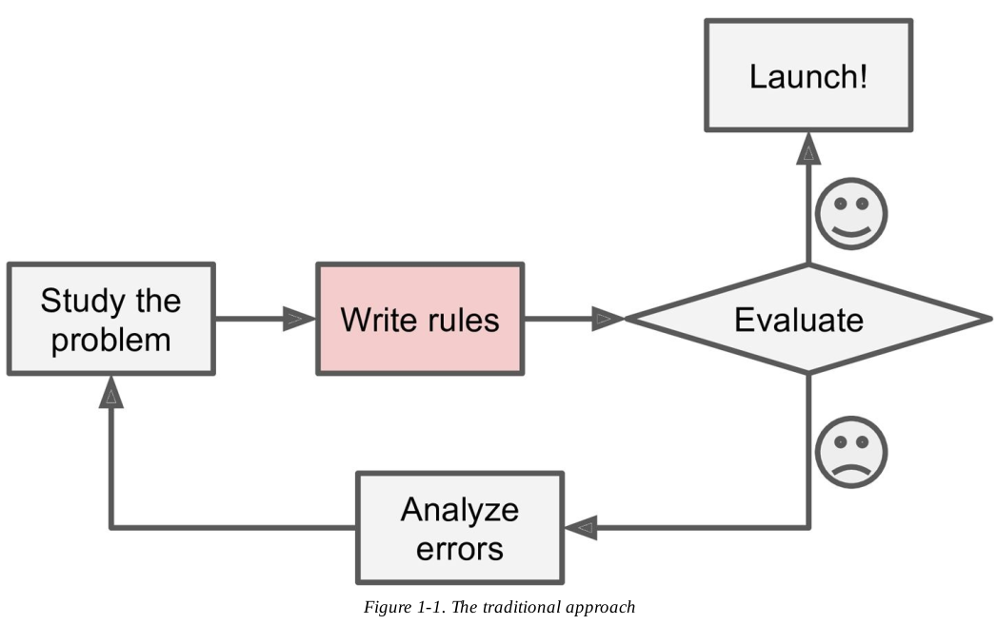
Traditional Approach

Slide 6
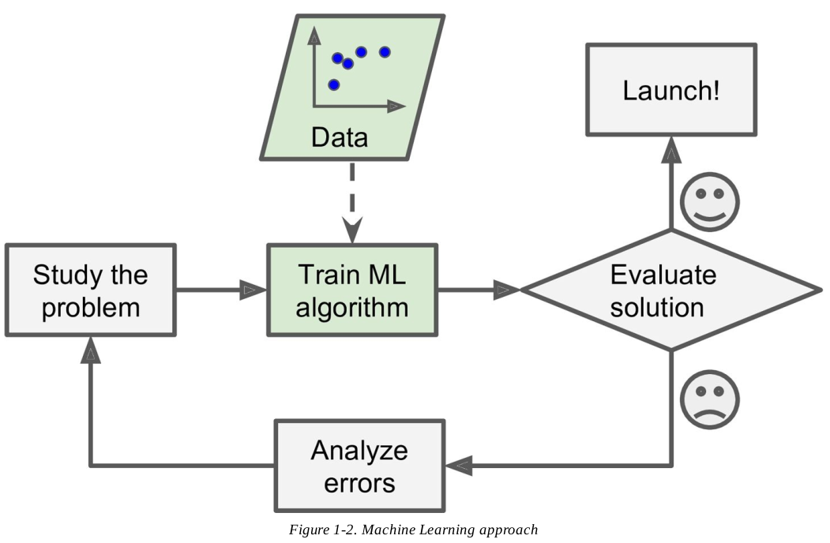
AI/ML Approach

Slide 7
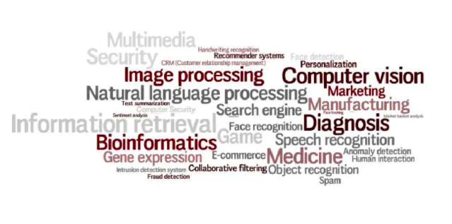
AI/ML Applications

Slide 8
Categories
Supervised learning
Unsupervised learning
Reinforcement learning

Slide 9
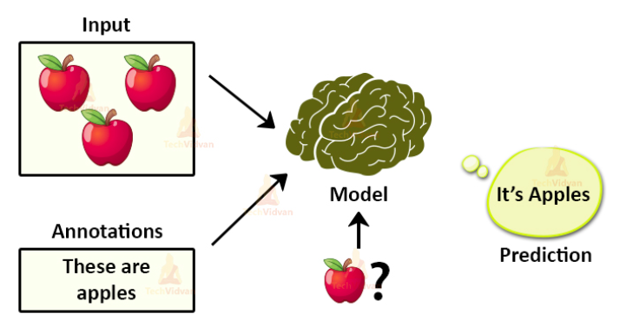
Supervised Learning

Slide 10
What is supervised learning?
Supervised learning is an approach to creating artificial intelligence (AI), where a computer algorithm is trained on input data that has been labeled for a particular output. The model is trained until it can detect the underlying patterns and relationships between the input data and the output labels, enabling it to yield accurate labeling results when presented with never-before-seen data.
Supervised learning is when the model is getting trained on a labelled dataset. A labelled dataset is one that has both input and output parameters. In this type of learning both training and validation, datasets are labelled as shown in the figures below.

Slide 11
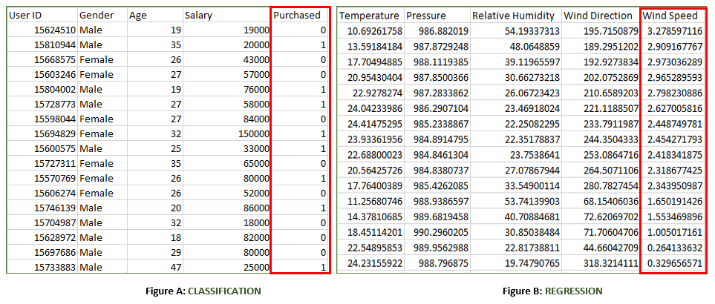

Slide 12
Both the above figures have labelled data set –
Figure A: It is a dataset of a shopping store that is useful in predicting whether a customer will purchase a particular product under consideration or not based on his/ her gender, age, and salary. Input: Gender, Age, Salary Output: Purchased i.e. 0 or 1; 1 means yes the customer will purchase and 0 means that the customer won’t purchase it.
Figure B: It is a Meteorological dataset that serves the purpose of predicting wind speed based on different parameters. Input: Dew Point, Temperature, Pressure, Relative Humidity, Wind Direction Output: Wind Speed

Slide 13
Types of Supervised Learning:
Classification: It is a Supervised Learning task where output is having defined labels(discrete value). For example in above Figure A, Output – Purchased has defined labels i.e. 0 or 1; 1 means the customer will purchase and 0 means that customer won’t purchase. The goal here is to predict discrete values belonging to a particular class and evaluate them on the basis of accuracy. It can be either binary or multi-class classification. In binary classification, the model predicts either 0 or 1; yes or no but in the case of multi-class classification, the model predicts more than one class. Example: Gmail classifies mails in more than one class like social, promotions, updates, forums.
Regression: It is a Supervised Learning task where output is having continuous value. Example in above Figure B, Output – Wind Speed is not having any discrete value but is continuous in the particular range. The goal here is to predict a value as much closer to the actual output value as our model can and then evaluation is done by calculating the error value. The smaller the error the greater the accuracy of our regression model.

Slide 14
Regression Algorithm | Classification Algorithm
In Regression, the output variable must be of continuous nature or real value. | In Classification, the output variable must be a discrete value.
The task of the regression algorithm is to map the input value (x) with the continuous output variable(y). | The task of the classification algorithm is to map the input value(x) with the discrete output variable(y).
Regression Algorithms are used with continuous data. | Classification Algorithms are used with discrete data.
In Regression, we try to find the best fit line, which can predict the output more accurately. | In Classification, we try to find the decision boundary, which can divide the dataset into different classes.
Regression algorithms can be used to solve the regression problems such as Weather Prediction, House price prediction, etc. | Classification Algorithms can be used to solve classification problems such as Identification of spam emails, Speech Recognition, Identification of cancer cells, etc.
The regression Algorithm can be further divided into Linear and Non-linear Regression. | The Classification algorithms can be divided into Binary Classifier and Multi-class Classifier.

Slide 15
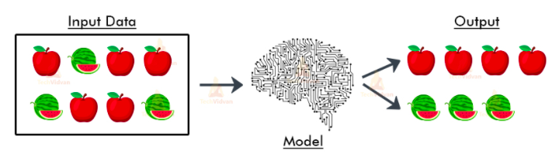
Unsupervised Learning

Slide 16
What is Unsupervised Learning?
As the name suggests, unsupervised learning is a machine learning technique in which models are not supervised using training dataset. Instead, models itself find the hidden patterns and insights from the given data. It can be compared to learning which takes place in the human brain while learning new things. It can be defined as:
Unsupervised learning is a type of machine learning in which models are trained using unlabeled dataset and are allowed to act on that data without any supervision.

Slide 17
Example: Finding customer segments
Clustering is an unsupervised technique where the goal is to find natural groups or clusters in a feature space and interpret the input data. There are many different clustering algorithms. One common approach is to divide the data points in a way that each data point falls into a group that is similar to other data points in the same group based on a predefined similarity or distance metric in the feature space.
Clustering is commonly used for determining customer segments in marketing data. Being able to determine different segments of customers helps marketing teams approach these customer segments in unique ways. (Think of features like gender, location, age, education, income bracket, and so on.)

Slide 18
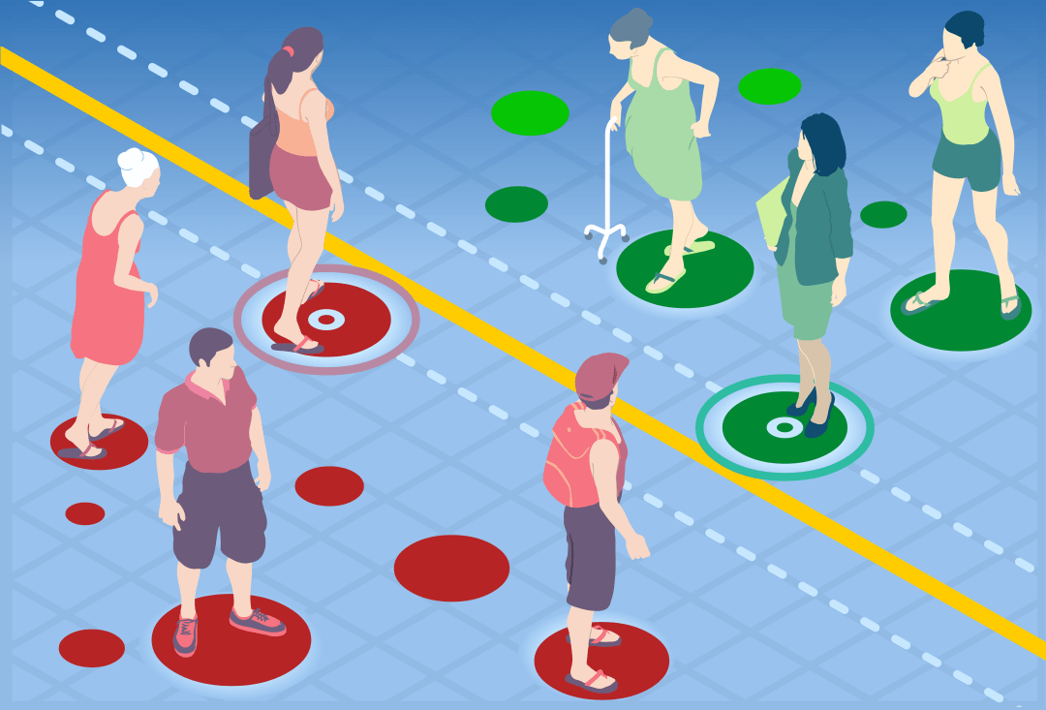

Slide 19
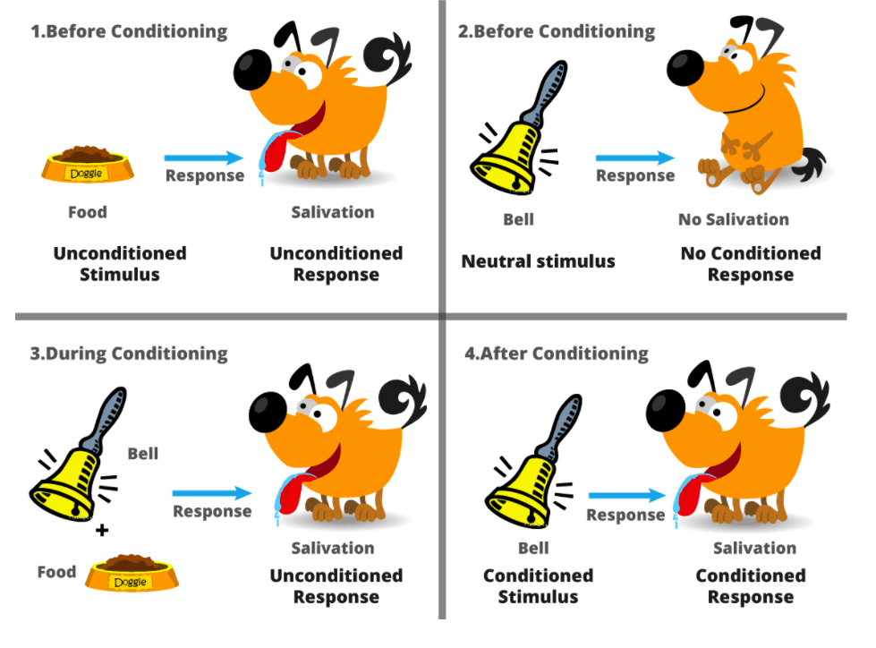
Reinforcement Learning

Slide 20
What is Reinforcement Learning?
Reinforcement Learning is a feedback-based Machine learning technique in which an agent learns to behave in an environment by performing the actions and seeing the results of actions. For each good action, the agent gets positive feedback, and for each bad action, the agent gets negative feedback or penalty.
Reinforcement learning is all about making decisions sequentially. In simple words, we can say that the output depends on the state of the current input and the next input depends on the output of the previous input

Slide 21
Example :
Self-driving cars: Reinforcement learning is used in self-driving cars for various purposes such as the following. Amazon cloud service such as DeepRacer can be used to test RL on physical tracks.
Trajectory optimization: Reinforcement learning can be used to train an agent for optimizing trajectories. In reinforcement learning, the software agents could get reward from their environment after every time step by executing an action in the state. Reward is typically normalized to [0, 1].
Motion planning including lane changing, parking etc
Dynamic pathing: Reinforcement learning can be used for dynamically planning the most efficient path in a grid of potential paths.
Controller optimisation
Scenario-based learning policies for highways

Slide 22
Any Questions ?

Slide 23
Thank You

